Slide 1
Connection
An attack on consumerism
Joe bonino

Slide 2

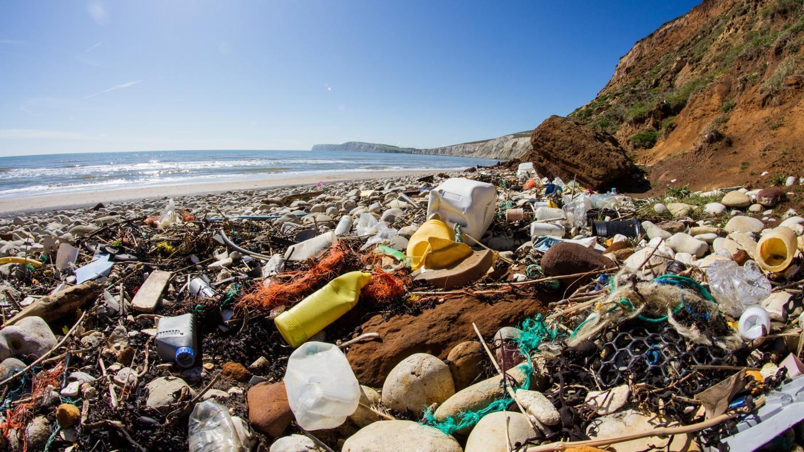
Background
Social Conquest of Earth – E.O. Wilson
Habitat destruction
Invasive species
Pollution
human over-Population
Overharvesting
Why Pollution?
Easiest fix
Big factor -> Consumerism

Slide 3
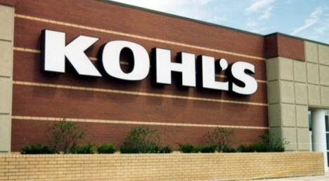
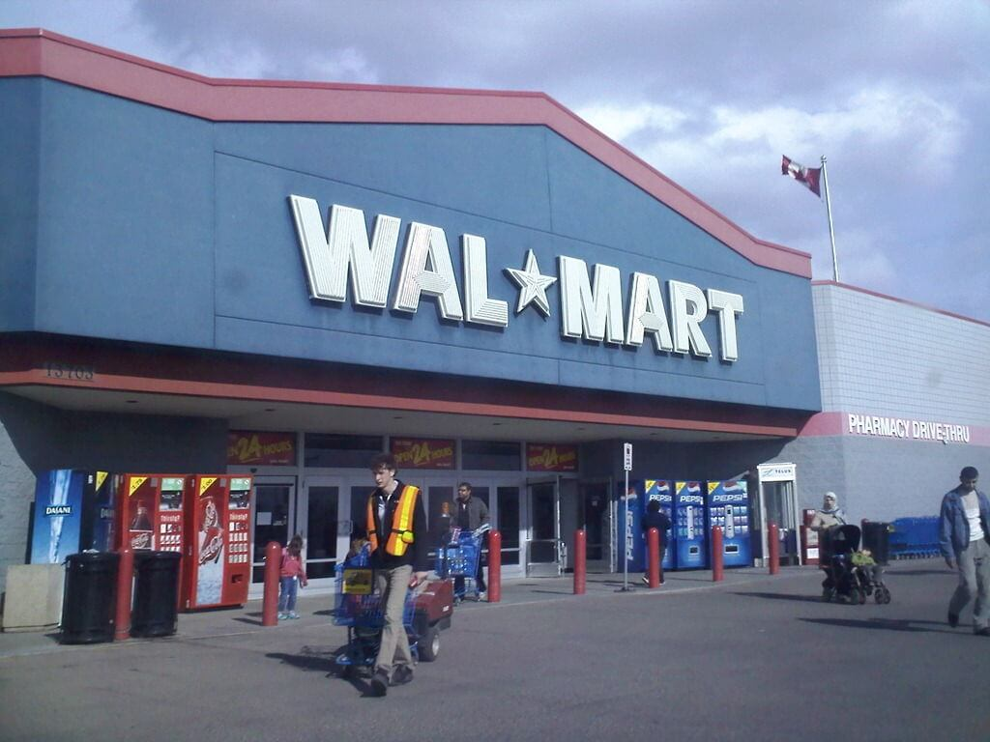
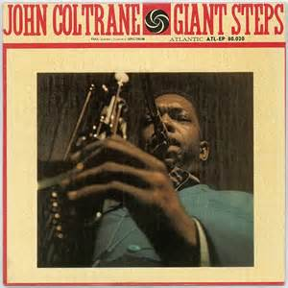
An Attack on Consumerism
First Take
Promoting Anti-Consumption
Very Radical – People shop
To giant of a step
Considered “Hipster”
Resolution
Connect consumer with product

Slide 4
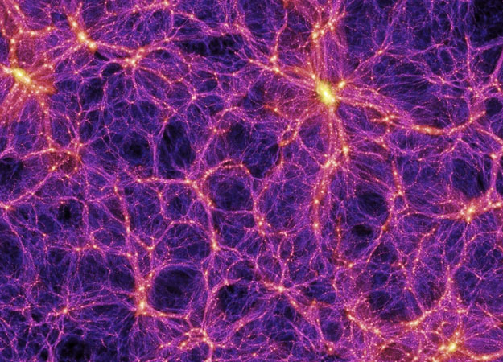

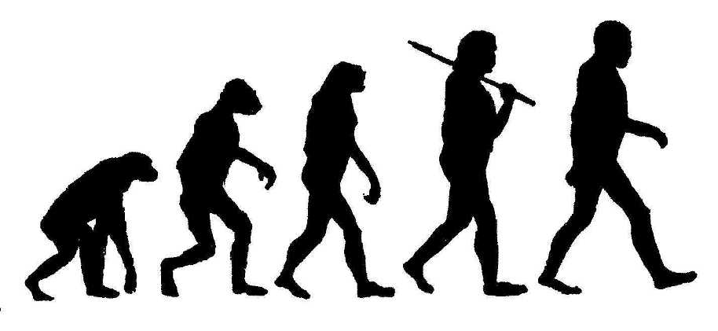
Back to the Biological Web
Establish a connection to consumer
Support good products
Keep it practical
Environment (Global)
Humanity (Local Group)
Health (Local)

Slide 5
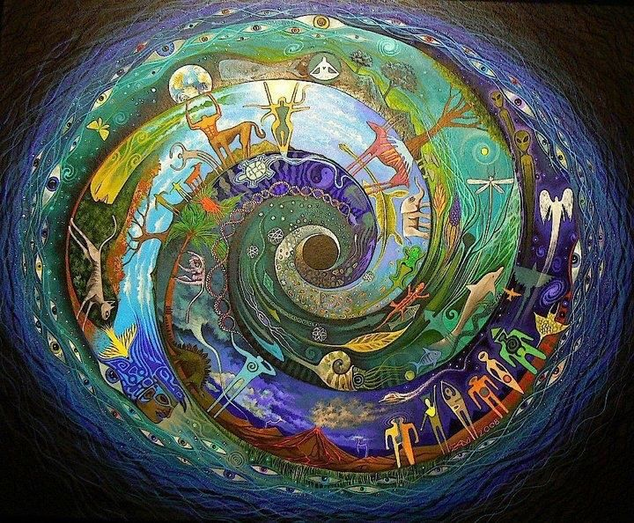
Connection
Existing Media Examples
Roger and Me - Humanity
Cowspiracy – Environmental
Eat, Fast & Live Longer - Health

Slide 6
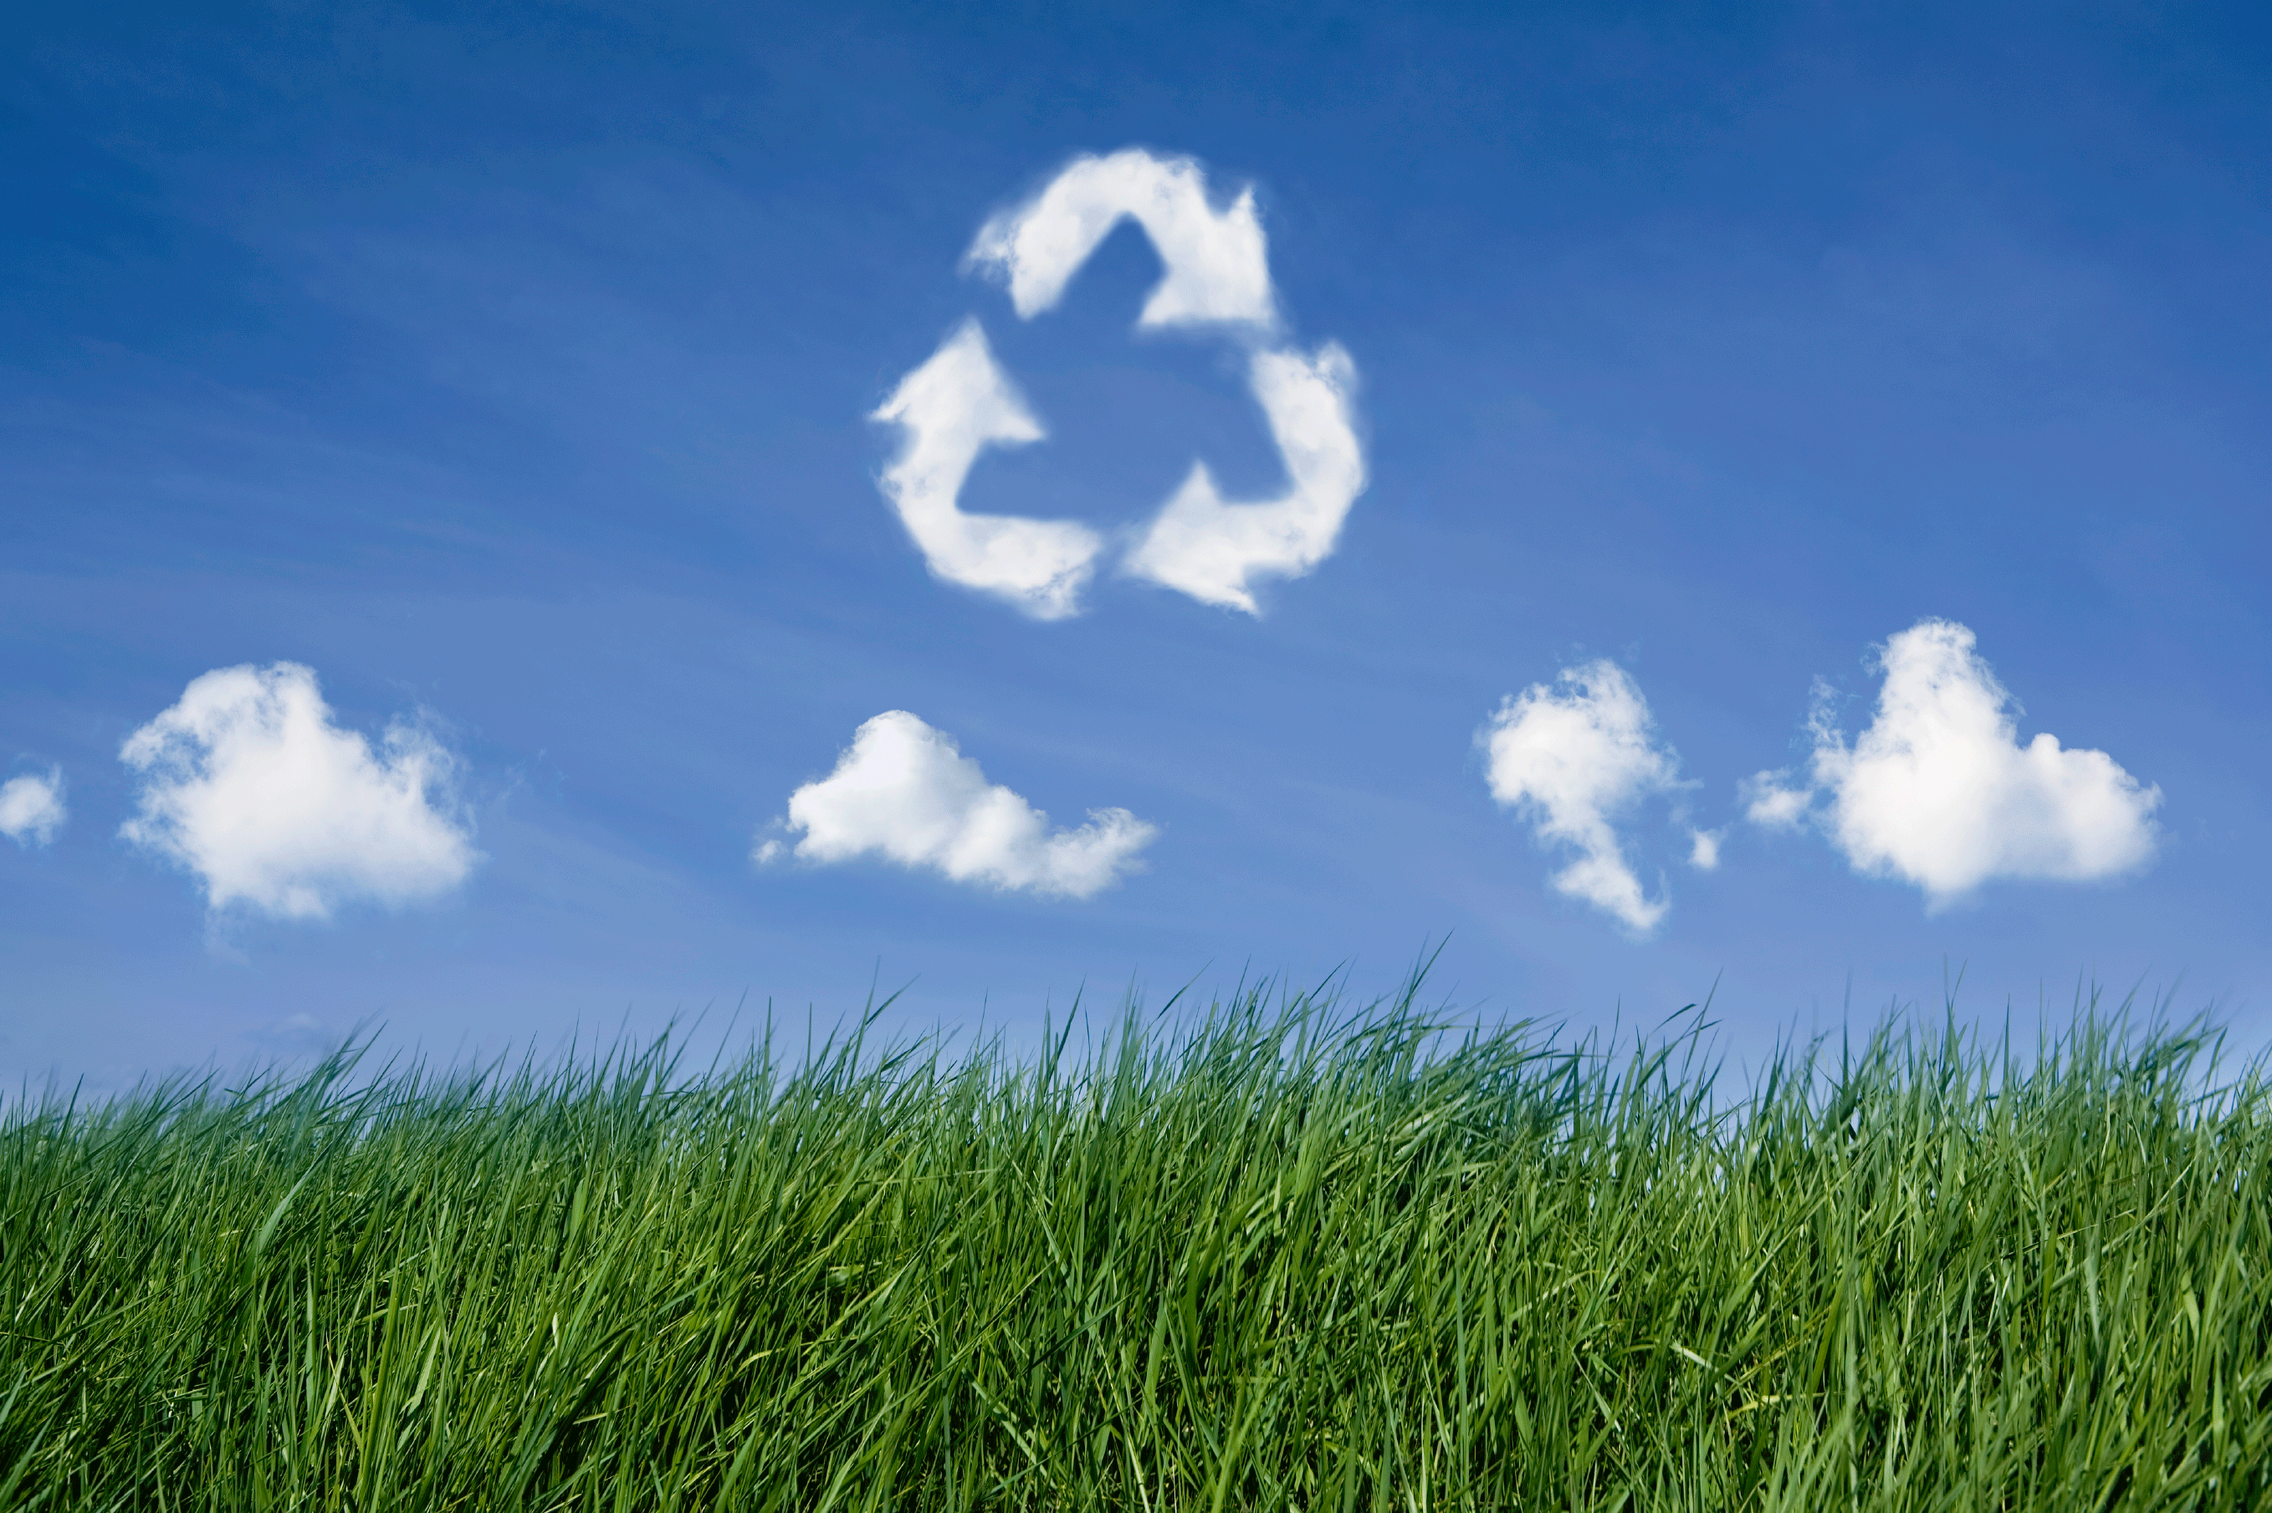
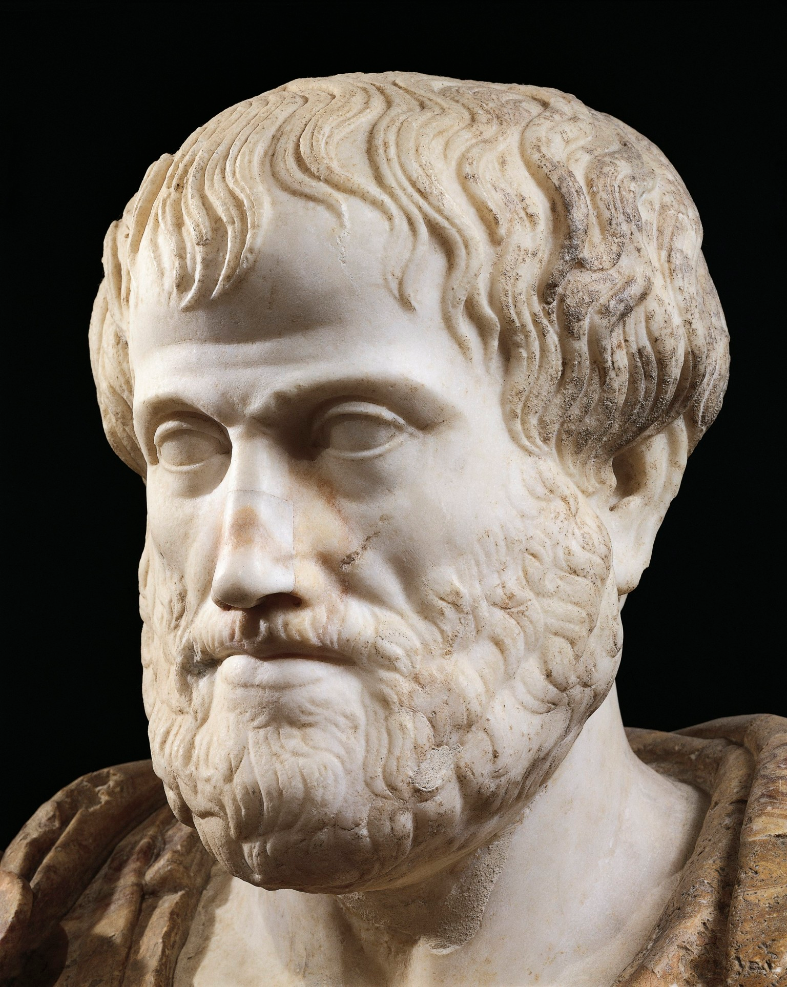
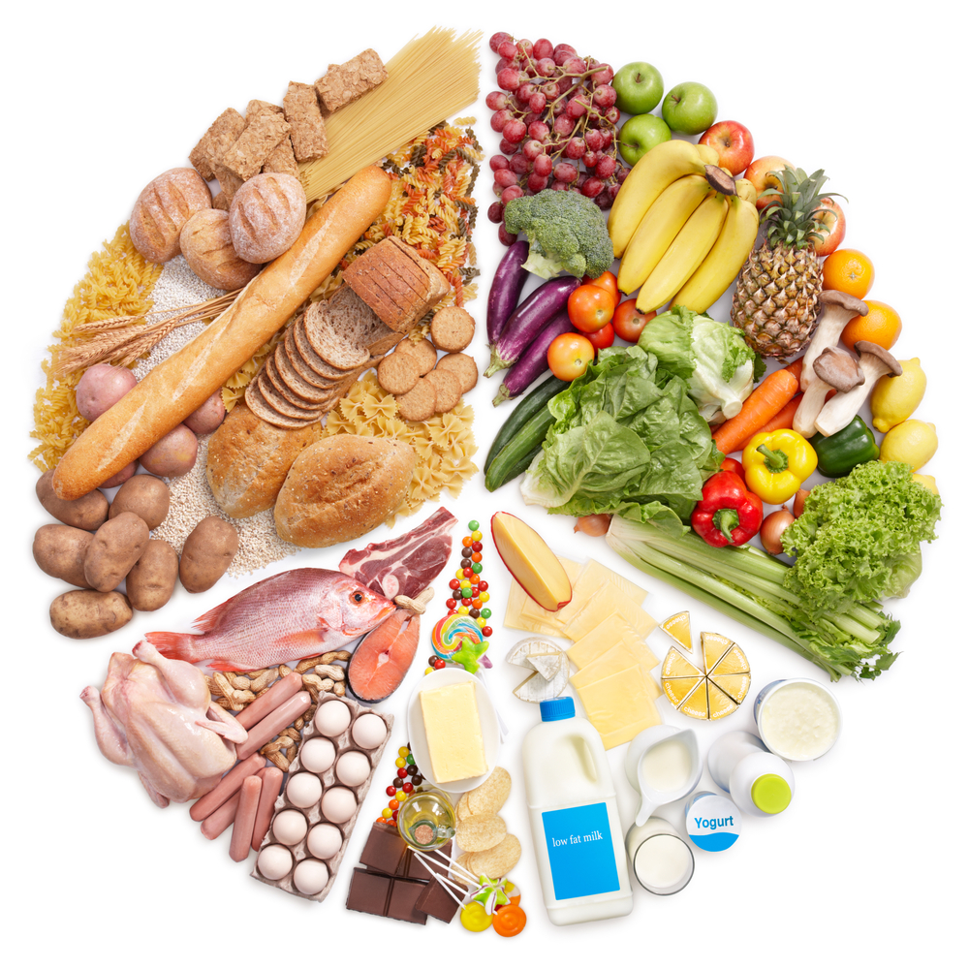
Example
Ribeye Steak
You will know
“cows produce more greenhouse gases than cars”,
“the farmers are in an outrageous contract with Walmart”,
“red meats aren’t the best for you”
Grass-fed organic Ribeye Steak
“Grass-fed cows prevent migration of animals”

Slide 7
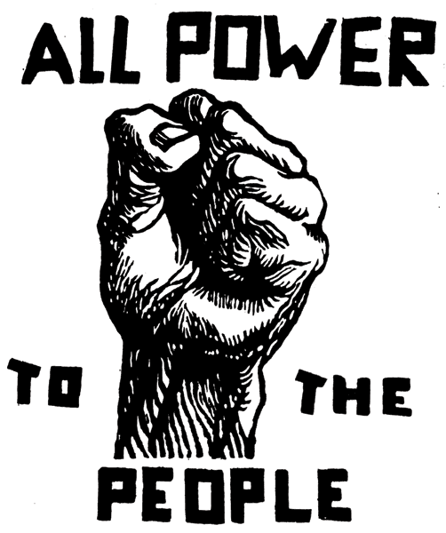
Who’s Providing?
Anyone with internet
How to keep info Credible?
Voting system
No incentive
Wikipedia, Reddit

Slide 8
Overview of the App
Native web app
Scan with phone
Each item has Reviews
Vote on reviews if they are worth knowing!
Time to design

Slide 9
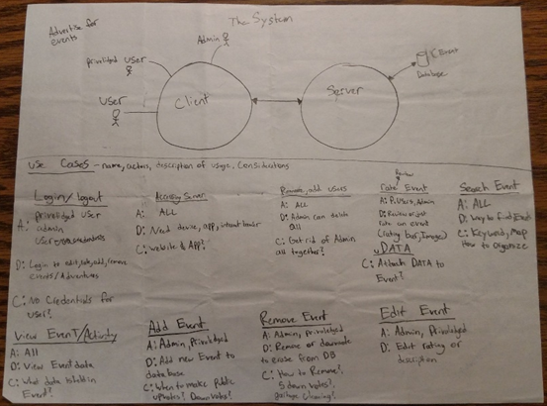
Design
Stay away from technology
Step 1. System boundaries
Paper and pencil
User, Privileged User, Admin
Simple Use cases
I kept it simple, stupid

Slide 10
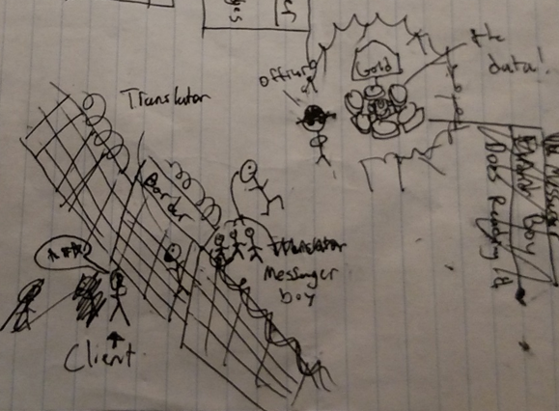
Analogies are great
The happy path
Identify Objects
Service Providers
Client
Translator
Messenger
Officer
Gold Mine
Great big picture, no details

Slide 11
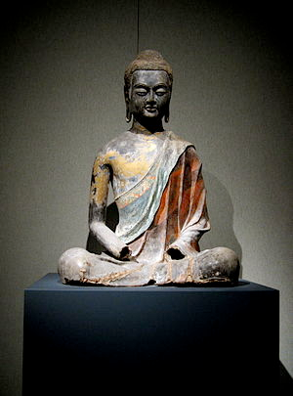
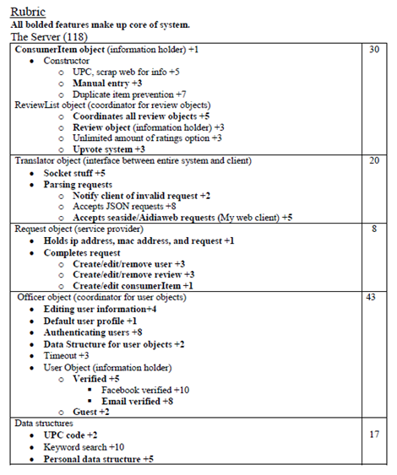
Rubric
Small stroke on insight
Point system brought priorities
Lots of points in the wrong places
Destined for Front-end Project

Slide 12
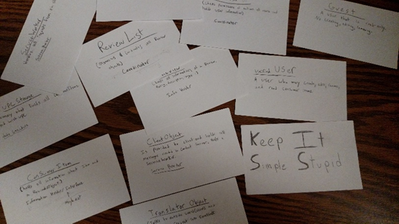
CRC’s Brilliance
Lectures are applying!
Determine many collaborators
Design never dies..
Agile or waterfall?
Redesigning means rewriting
“The only kind of writing is rewriting.” – Ernest Hemingway

Slide 13



Technology
Smalltalk
Front and Back ends live here!
System living, easy debugging
The Front-End
Seaside – Book
ZincServer
Bootstrap (responsive)

Slide 14
Elaborate html
WAComponent instance
renderContentOn: html
html heading: ‘That was easy’
Seaside Components
One or multiple per page
Register components
Tedious
Inheritance
renderContentOn: html
Children
Style
Children
^Array with: aComponent
style
^’ body {background-color:blue;} ‘

Slide 15
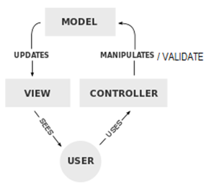
A broad take: MVC
Model -> Smalltalk object
View -> Seaside Component
Controller
callback message
Provides parameters as object
Multiple flows on same page
Call and Answer
renderContentOn: html
html button
callback:[ self smallTalkFunc ];
with: ‘Submit’.
html textInput
callback:[:input | instVar:= input].

Slide 16
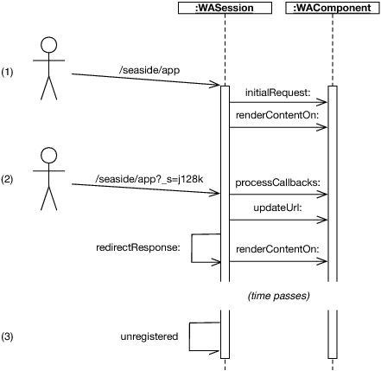

Sessions
Session initialized
They expire automatically
Process callbacks
Control flow
Specialize it

Slide 17
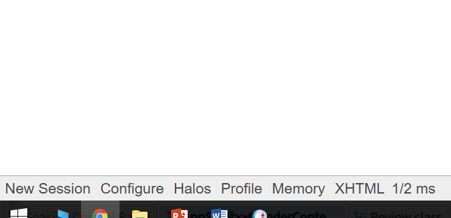
Developer Library
Use the Smalltalk debugger on exceptions
Halos
Profile - REST
Memory
XHTML checker
Source html/css
Remove for deployment

Slide 18
Features
User
See saved, upvoted & downvoted
Add items, reviews, vote
UserStructure
Change pin
New User
Forgot password
UpcStructure
NewsPage
Error Checking
Pin,titles,username are Static

Slide 19
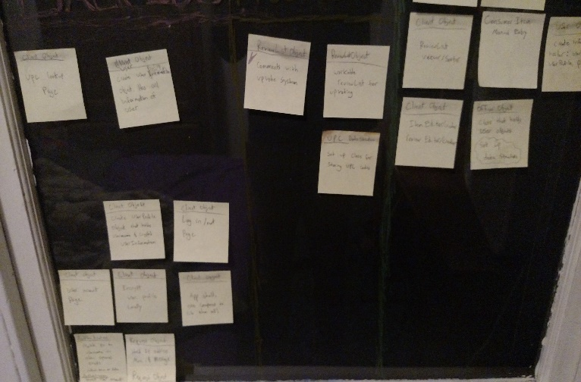
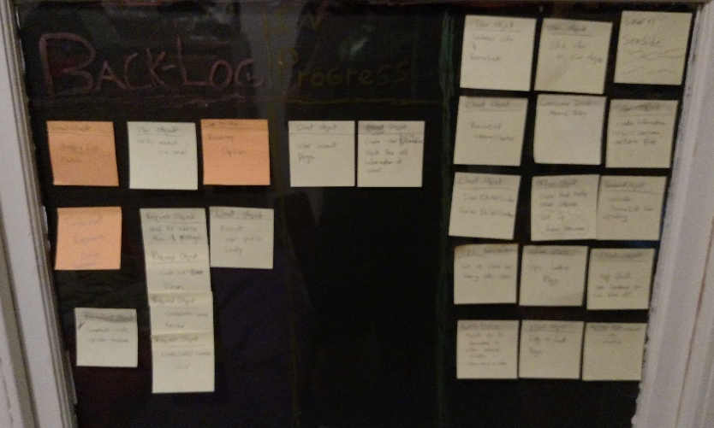
A more coordinated sprint
Three sections in window
Backlog
In Progress
Complete
Notes in pharo
Forgot responsive design

Slide 20
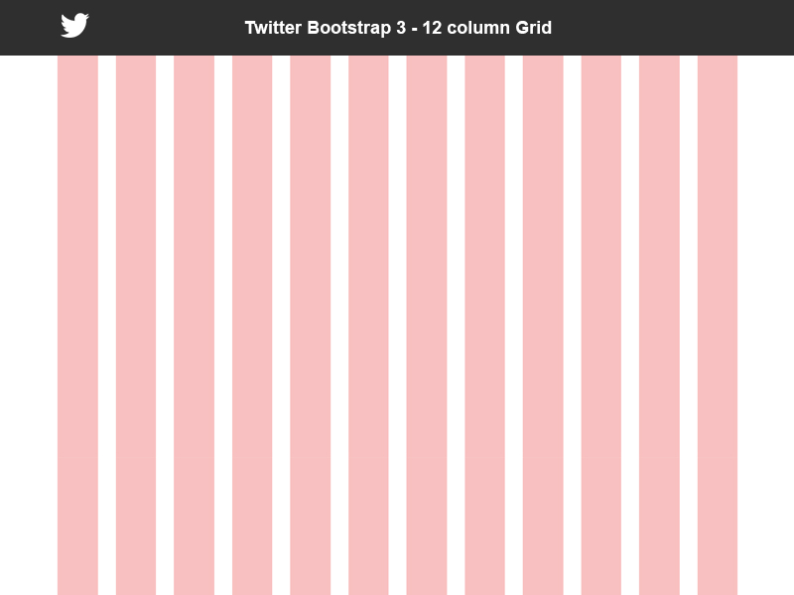
Responsive Design (Bootstrap)
Bootstraps grid system
Great looking elements
Different experience
for different devices

Slide 21
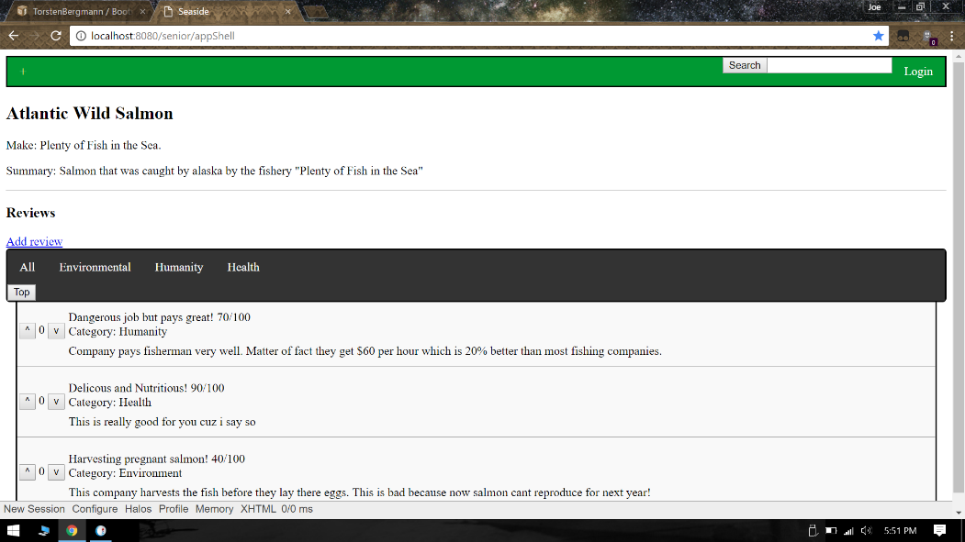

Slide 22
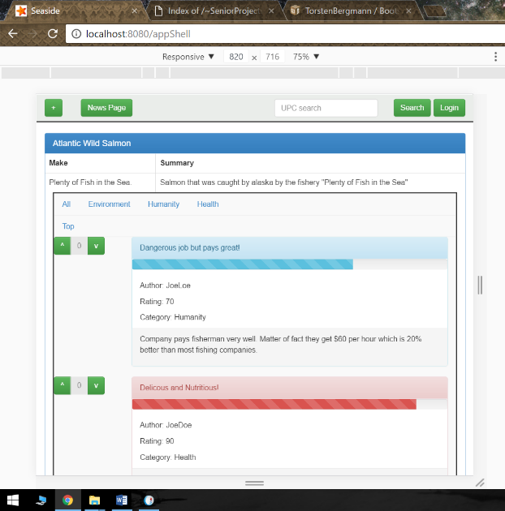

Slide 23
What I learned
I don’t know anything
Smalltalk, seaside, bootstrap in one semester = flexible brain
Much bigger picture
Close to zero documentation for Smalltalk
No distractions
Massive projects take a toll psychologically

Slide 24
What I would do different
Focus on back-end development. No client app
Work with an Apache server

Slide 25
Thank you!

